Slide 1
A Real-Time Heart-Rate Monitor Using Non-Contact Electrocardiogram for Automotive Drivers
Rahul Kumar Singh, Archisman Sarkar, Rupak Kumar Thakur, Anoop C. S.
Indian Institute of Technology, Kharagpur, India
Notes:
Good evening, I am Anoop from Dept. of EE, IIT KGP. Today, I will be presenting my work which is based on the design and development of HR monitor for suited for automotive drivers.

Slide 2
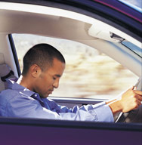
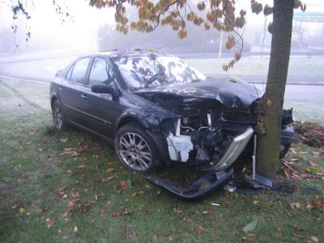
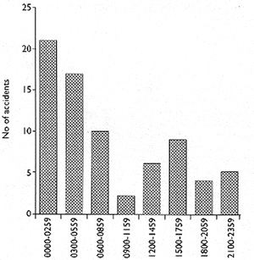
Motivation: Real Time Monitor for Automotives
National Highway Traffic Safety Administration reports 100,000 driver fatigue related crashes each year in U. S.
Results in 1,550 deaths, 71,000 injuries, $12.5 billion loss.
Driver Fatigue is a major Cause of accidents in India
No of accidents during different hours of a day
Source:
www.theinjurylawyers.com
Ruikar M. National, “Statistics of road traffic accidents in India,” J Orthop Traumatol Rehabil 2013;6:1-6
www.bmj.com/content/310/6979/565
Notes:
A large no of accidents occur due to the fatigue of the vehicle driver. Statistics show alarming numbers. For instance, about 1500 deaths have occurred in US. Similar is the case in India as well. These accidents are reported to occur in early morning and immediately after post lunch sessions. These times correspond to the duration when the driver is more likely to be fatigued. Hence, to reduce such accidents and associated fatalities, real monitoring of driver state is required. Different methods are available to develop such real-time monitors. Most commonly used method is to use a camera and related image processing technques.

Slide 3
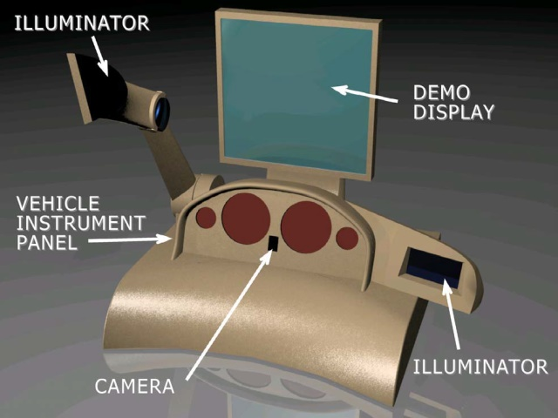
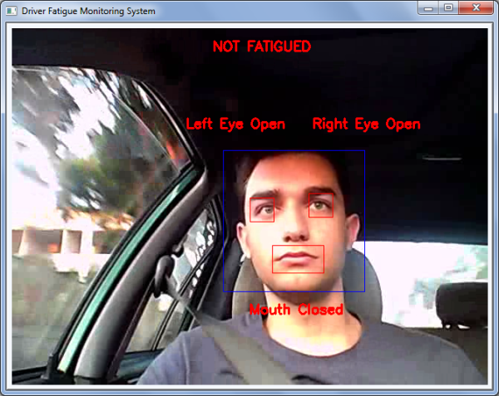
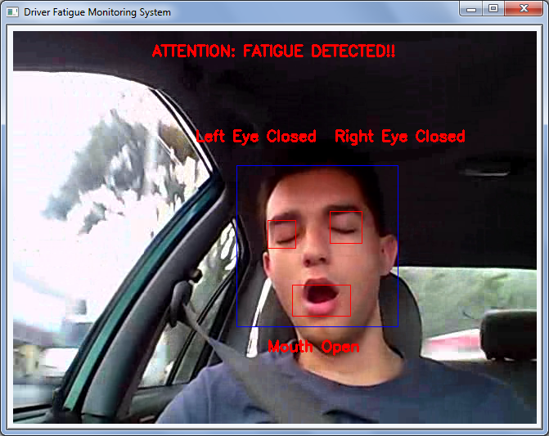
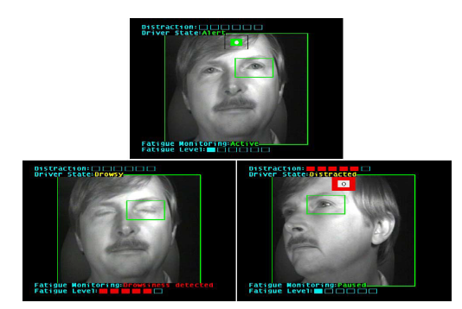
Existing Assistive Techniques for Automotive Drivers
Camera Based Solutions
Facial Features for Drowsiness Detection^{[2]}
Prototype of a Vision based Solution from Delphi^{[1]}
Normal Condition
Normal Condition
Drowsy Condition
Drowsy Condition
[1] N. Edenborough, et. al. “Driver State Monitor from DELPHI,” IEEE CVPR 2005, vol.2, no., pp.1206-1207 vol. 2, 20-25 June 2005
[2]http://staff.um.edu.mt/reuben.farrugia/ug/may2011_sacco_matthew.html
Eye Closure for Drowsiness Detection^{[1]}
Notes:
As shown in the figure. Such solutions use signal processing techniques to identify the closure/blinking of the eye or uses the images to identify whether person is yawning.

Slide 4
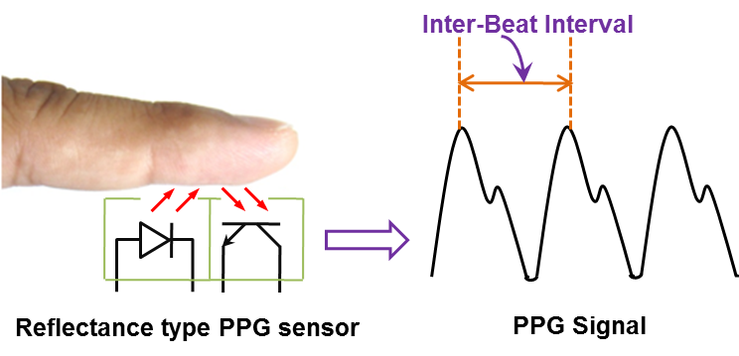
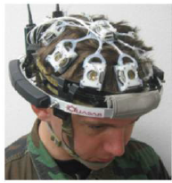
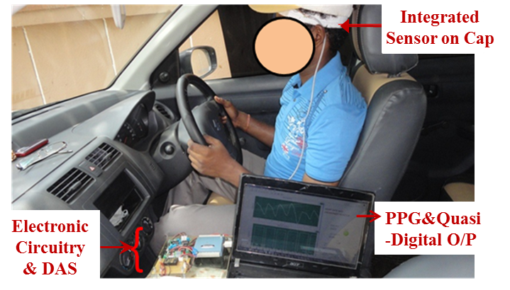
Existing Assistive Techniques for Automotive Drivers
Bio-Signal Based Solutions
Electroencephalogram (EEG) Based System^{[3], [4]}
Photoplethysmography (PPG) Based System^{[5]}
EEG Electrodes
Require Large Number of Electrodes
Should be worn on human head
Requires Complex Signal Processing stages to get information from relatively noisy EEG signals
[3] Seungchan Lee, “Review of Wireless Brain-Computer Interface Systems, Brain-Computer Interface Systems - Recent Progress and Future Prospects,
http://www.intechopen.com/books/brain-computer-interface-systems-recent-progress-and-future-prospects/review-of-wireless-brain-computer-interface-systems
[4] C. Lin et. al., "EEG-based drowsiness estimation for safety driving using independent component analysis," IEEE Trans. Circuits and Systems I: Regular Papers, vol. 52, no. 12, pp. 2726-2738, Dec. 2005.
Simple, Low-cost System, Convenient to Wear
require direct optical contact with the body of the driver
[5] S. Krishnamoorthy, C. S. Anoop, B. George, "A robust and non-invasive heart-rate monitoring system," in Proc. IMEKO TC4 Symposium, Barcelona, Spain, July 2013.
Notes:
Alternately, biosignal based solutions are also reported. EEG electrodes are used for sleep identification. But is requires

Slide 5
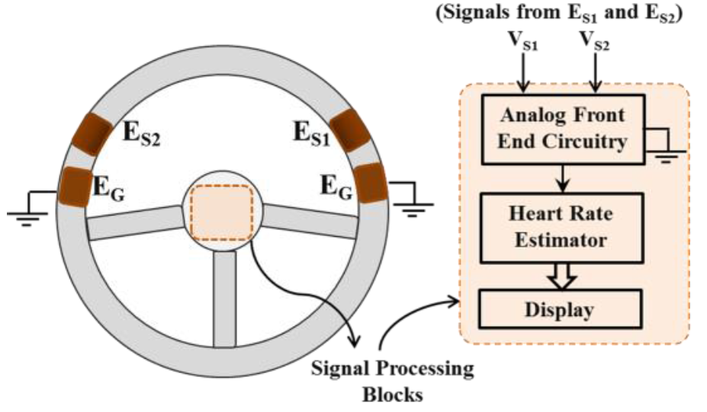
Proposed Technique Using Non-Contact ECG
simple and easy-to-integrate configuration
Do not require direct-optical contact with human body
Low noise Solution
Non-Contact ECG Electrodes on a Steering Wheel
E_{S1}, E_{S2} – Sensing ECG Electrodes, E_{G} – Ground Electrodes
E_{G} kept close to Sensing Electrodes to reduce common mode noise
Signal from E_{S1}, E_{S2} is processed to get clean ECG signal and heart rate indication

Slide 6
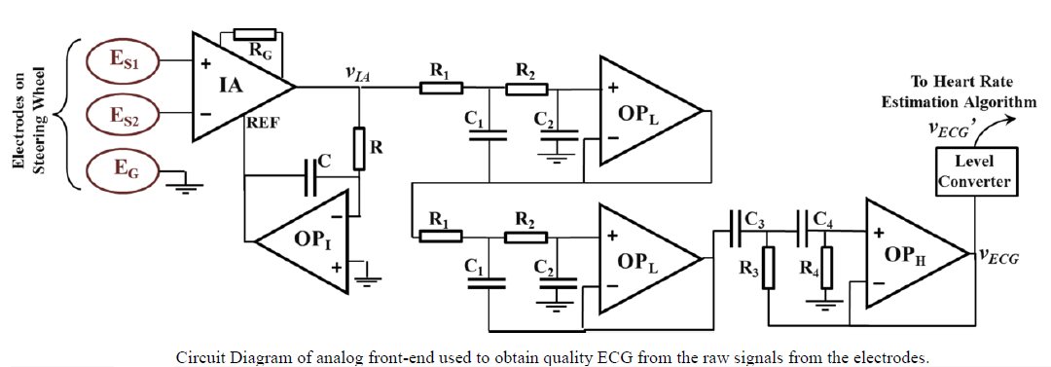
Detailed Schematic
IA – Instrumentation Amplifier for obtaining Single ended ECG signal
OP_{I} – Opamp Integrator for Base line stabilization
4th Order Low Pass Filter for High Frequency Noise Rejection,
Cut-off frequency: 20 Hz
2nd Order High Pass Filter for Supressing Respiratory artifacts

Slide 7
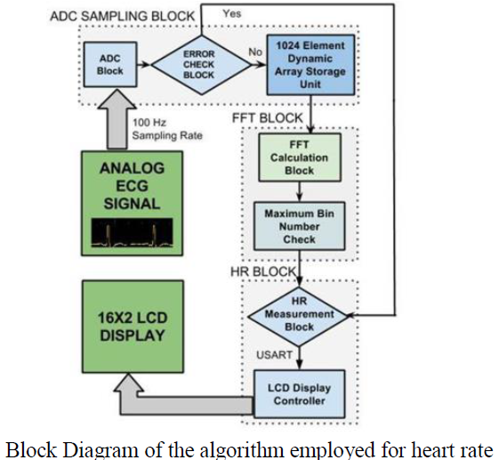
Heart Rate Estimation Unit

Slide 8
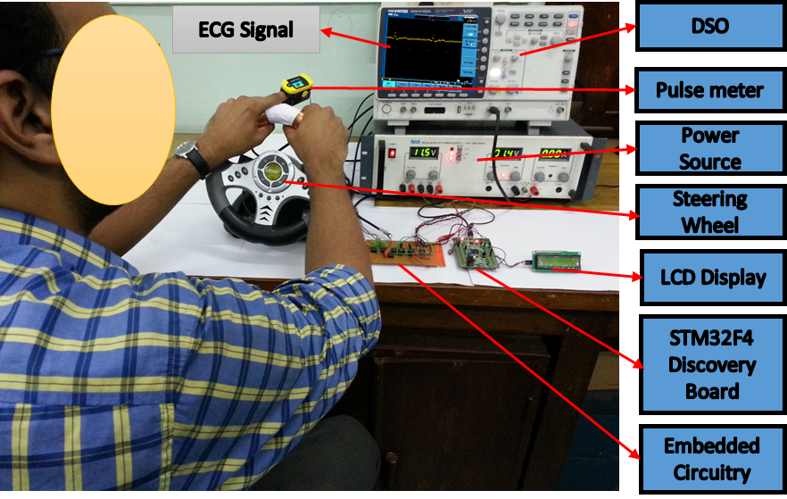
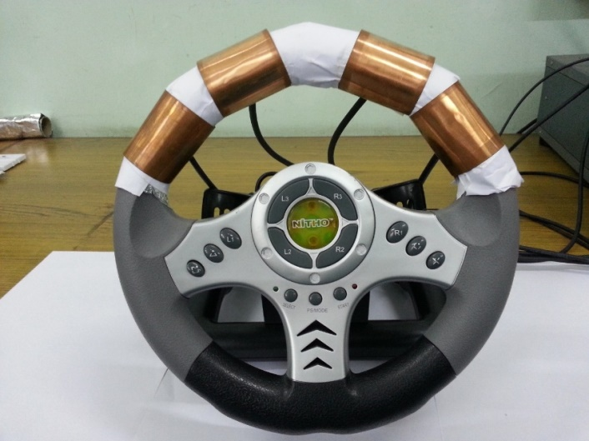
Prototype System
E_{S2}
E_{S1}
E_{G}
E_{G}
Electrode Placement on a Steering Wheel Model
E_{S1}, E_{S2} – Sensing ECG Electrodes
E_{G} – Ground Electrodes
Low cost Copper (Cu) strips of 0.2 mm thickness
List of Components Used
Testing of the Developed Prototype on a Volunteer
Component | Part No.
Instrumentation Amplifier | INA129
Opamps | OP07
HR estimation unit | STM32F4 board
LCD | Hitachi HD44780

Slide 9
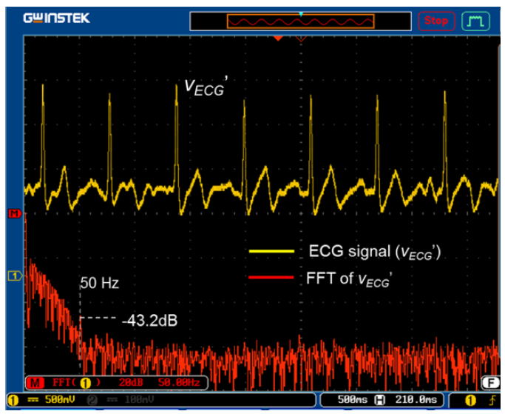

Experimental Results
ECG waveform obtained on testing the developed scheme with a volunteer

Slide 10
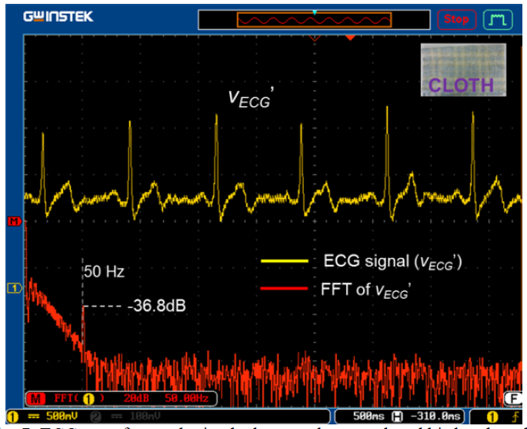
Experimental Results with Cloth Fabric
Hand is not in direct contact with the electrodes.
Cloth of 2mm thickness used
ECG of good quality obtained
SNR of the signal reduced with increase in cloth thickness.

Slide 11
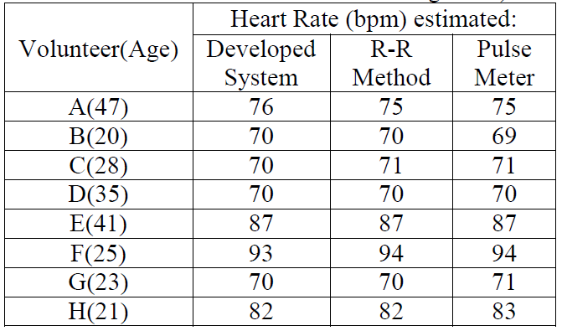
Developed System as a Heart Rate Monitor – Test Results
[7]
Case 1: Hand of Driver is in direct contact with electrodes on steering wheel.
Worst-Case Error in Heart Rate Estimation <= 2 bpm
[7]
Case 2: Fabric (0.5 mm thickness) is present between the palm and steering wheel.
[7] ChoiceMMed Pulse Oximeter. [Online]. Available:
store.choicemmedamerica.com/collections/pulse-oximeter/products/c20

Slide 12
Developed System as HR Variability Monitor – Test Results
Volunteers requested to give a nap test and HR was monitored constantly.
Decrease in HR when the person went into nap state.
Can be detect driver fatigue and alerting driver (e. g., audio signal)

Slide 13
Conclusions
Developed a simple heart rate monitoring system suitable for automotives.
Principle of non-contact ECG was integrated on a steering wheel.
Simple analog signal conditioners and digital computation unit used.
Good quality ECG signals even when the subject held the steering wheel
Error in HR estimated less than 2 beats per minute.
Developed system can be successfully incorporated in vehicles to ensure the safety of automotive drivers.

Slide 14
THANK YOU

Slide 15
